Slide 1
PROJECT
Skin Cancer Classification
With Deep Learning
Using CNN Model

Slide 2

SOURCE OF DATA
Link- Click Here To Go To Data Source Page
RESEARCH Parer
Link1- Click Here To Go To Project Paper Page​
Link2- Click Here To Go To Project Paper Page​

Slide 3
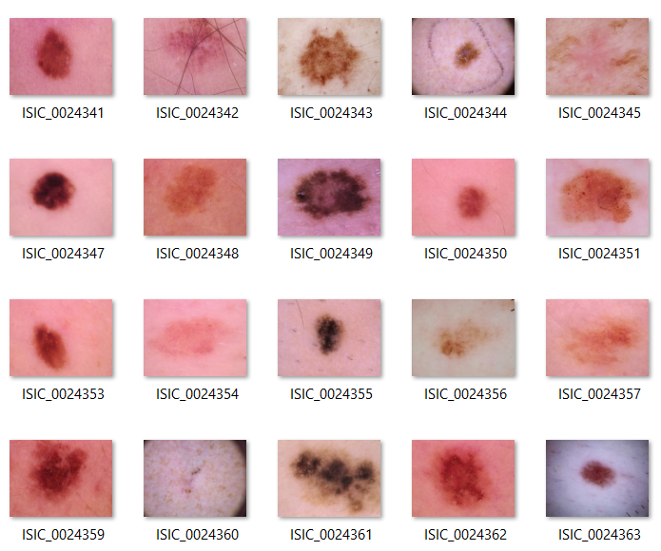
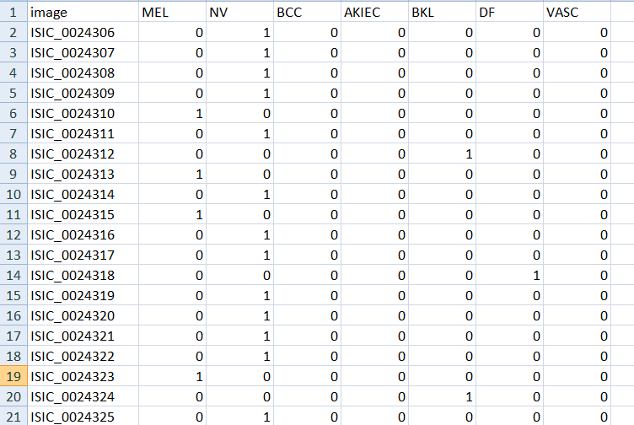
Data Collected From ISIC
Image Datasets
Ground Truth Values

Slide 4
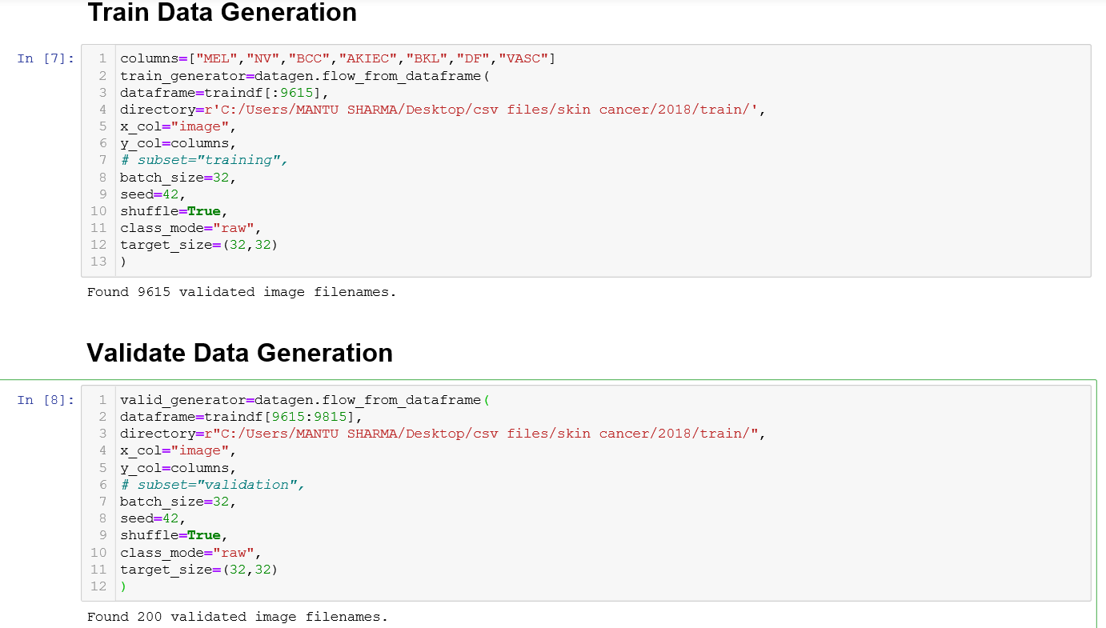
Creating training and Validating Datasets using -flow_from_dataframe

Slide 5
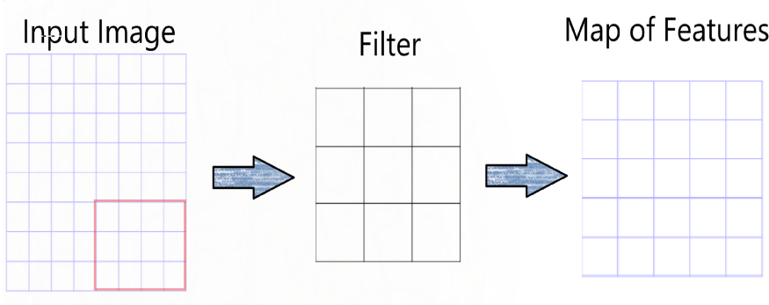
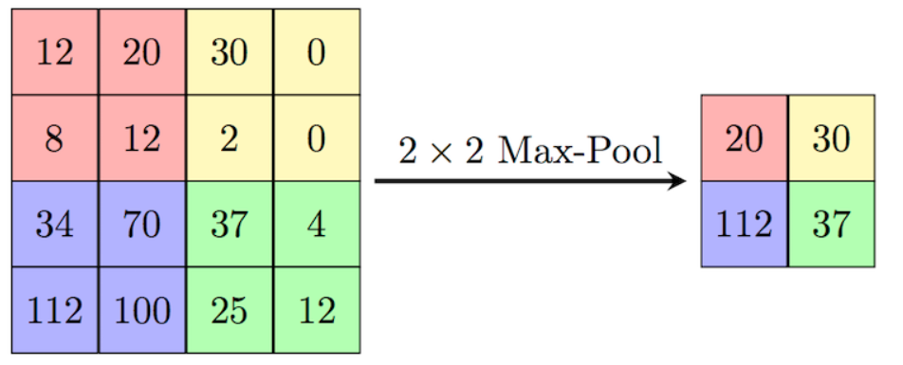
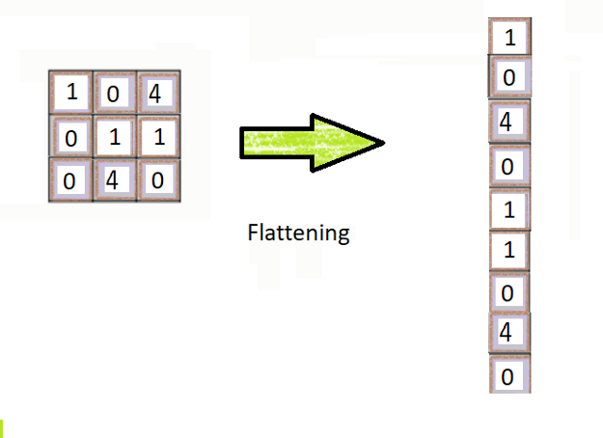
Model OVERVIEW
Step 1 - Input Image:
Step 2- Convolution:
Apply filters for feature detection
Step 3- Max Pooling:
Purpose-To detect image in case flipped, inverted...etc.
Step 4 — Flattening:
Converting data from matrix to column

Slide 6
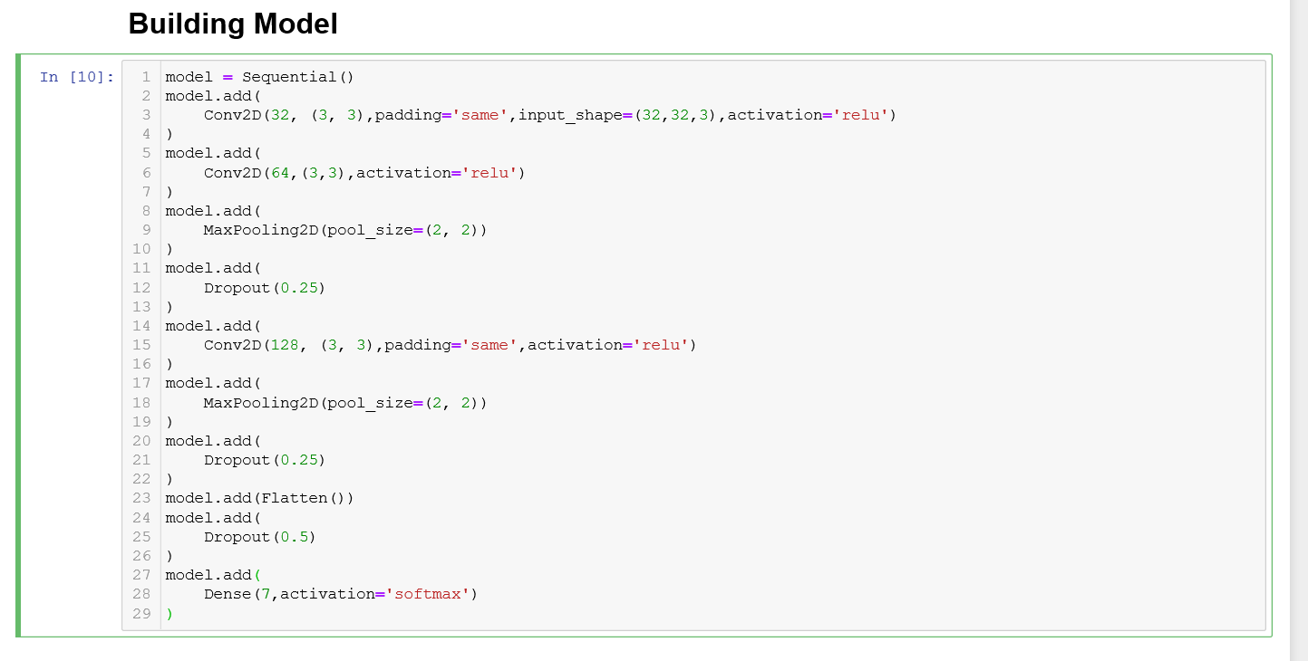
Building Model..

Slide 7
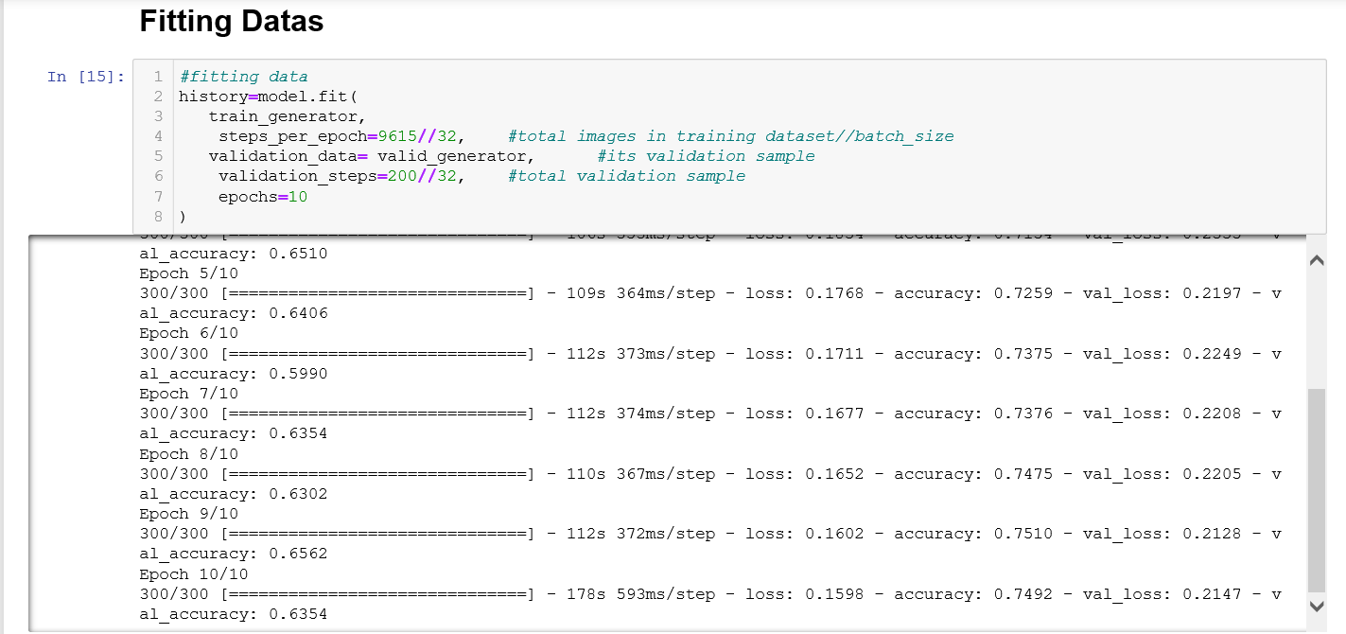
Fitting Datas To Model

Slide 8
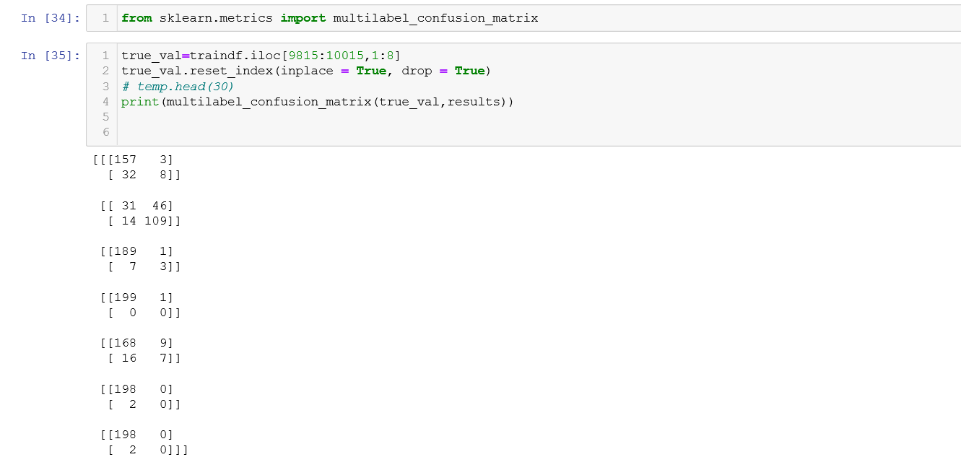
Confusion matrix for testing data

Slide 9
For Large Datasets with dimensions
Types | Count
Training data | 18999
Validation data | 6332
Testing data | 8238

Slide 10
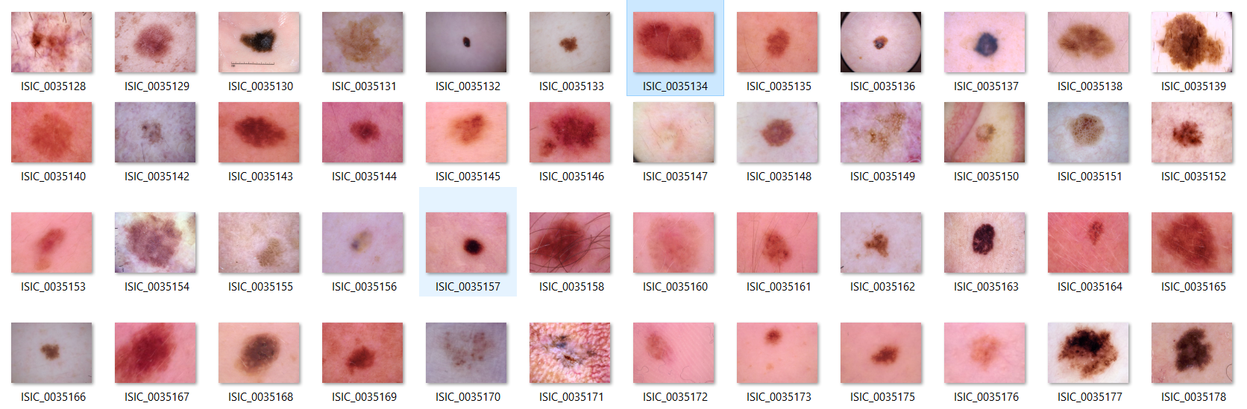
Sample Image Datasets

Slide 11
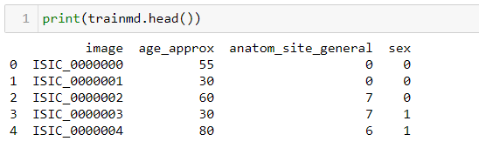
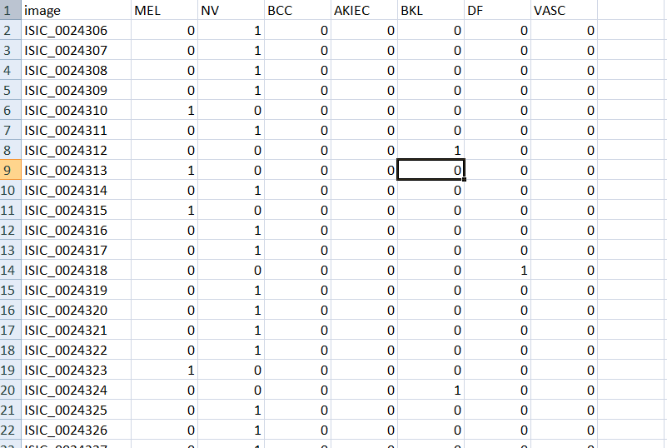
Sample view of Metadata & Ground Truth

Slide 12
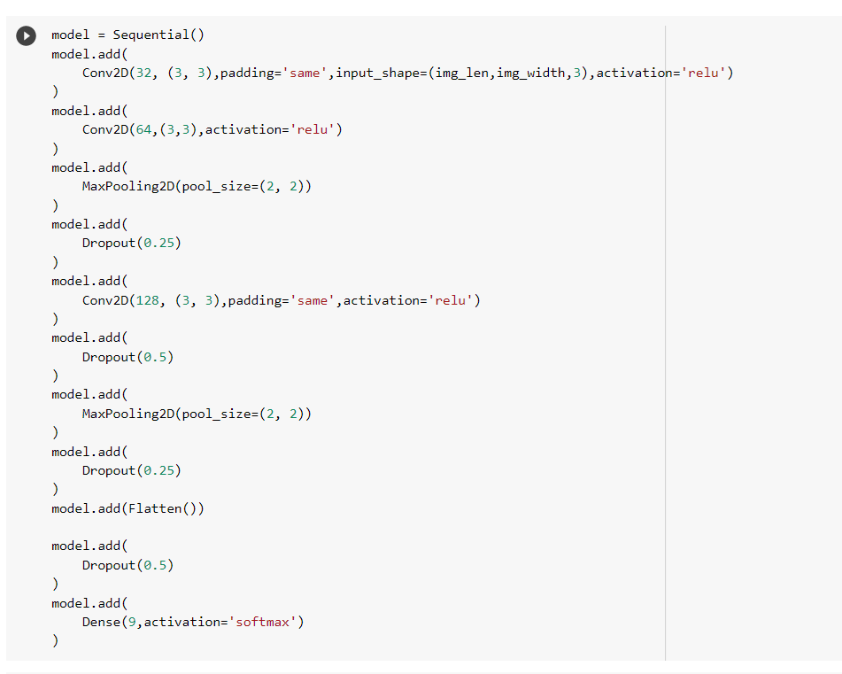
Building model

Slide 13
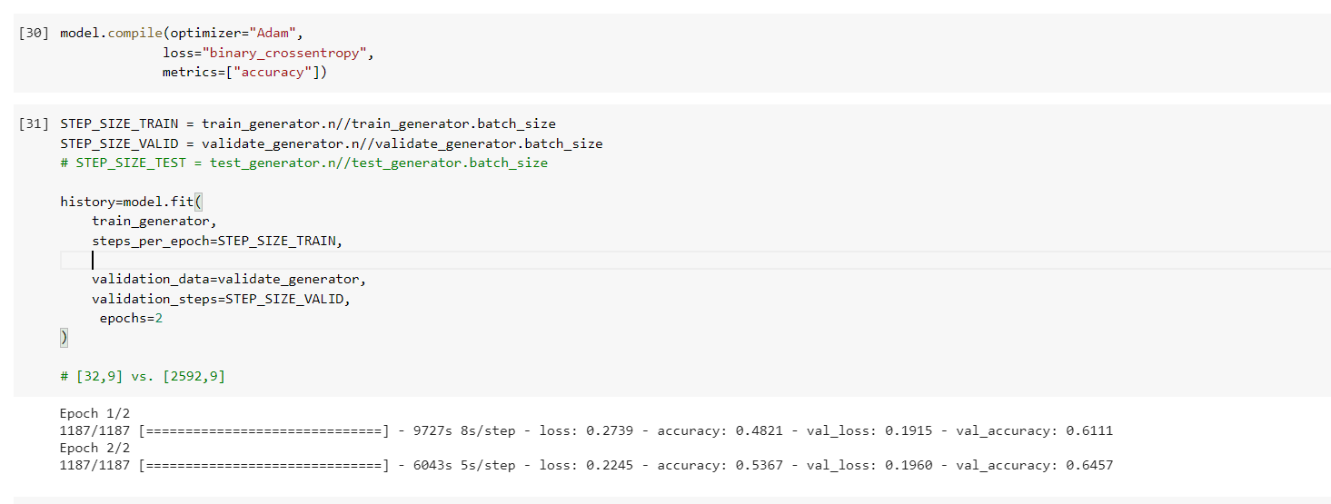
Compiling & Training Model

Slide 14
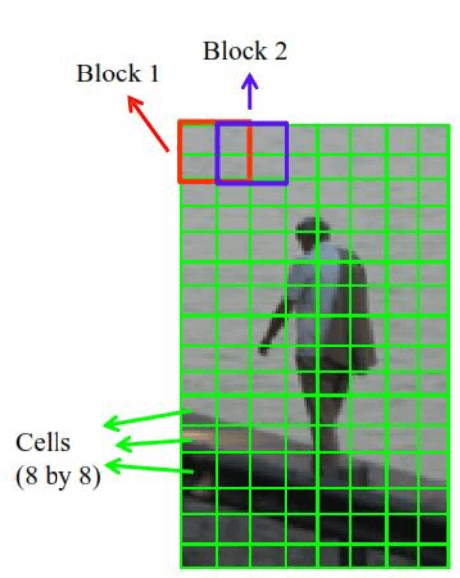
HOG Feature Extraction
HOG –Histogram of Oriented Gradient.
Used for the object detection
Mainly focus on the edge of the object and orientation of edges also.
STEPS-
First Resize image into some specific dimensions say (64*128)
The image further divided into small parts say (8*8) as shown.
Now gradient and the orientation of gradient for each these small blocks calculated

Slide 15
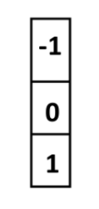

Calculating Gradients & orientation
For This we need to calculate the gradient in the x and y direction. Then merge them to get final gradient and orientation/slope.
For X direction-
For Y direction-
Equation=> y = -x
Equation=> y = x – 1

Slide 16
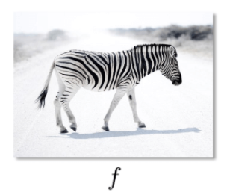


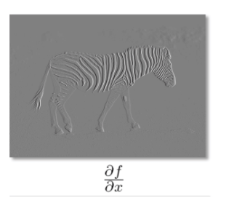
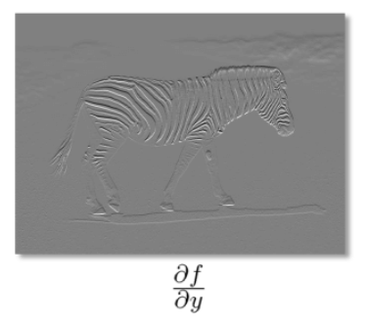

Slide 17
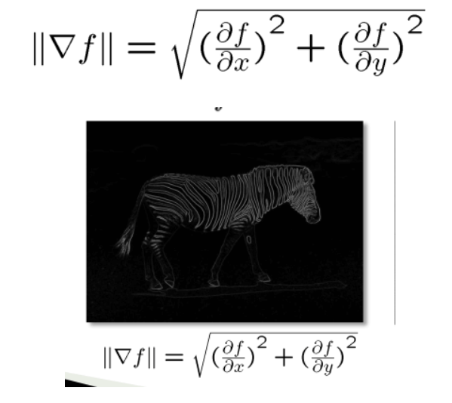

Overall Gradient (magnitude)
Orientation of Gradient

Slide 18
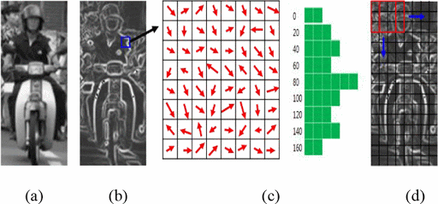
EXAMPLE-

Slide 19
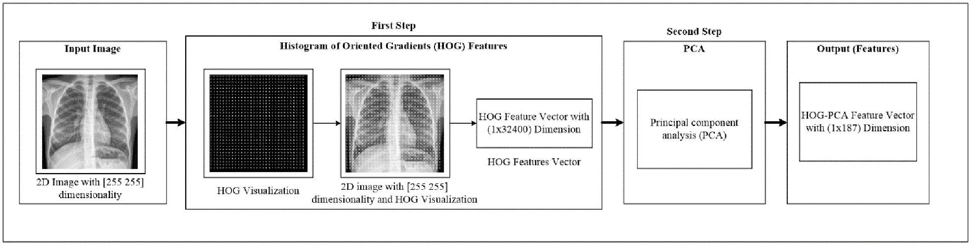
Flow Chart for HOG Feature Extraction

Slide 20
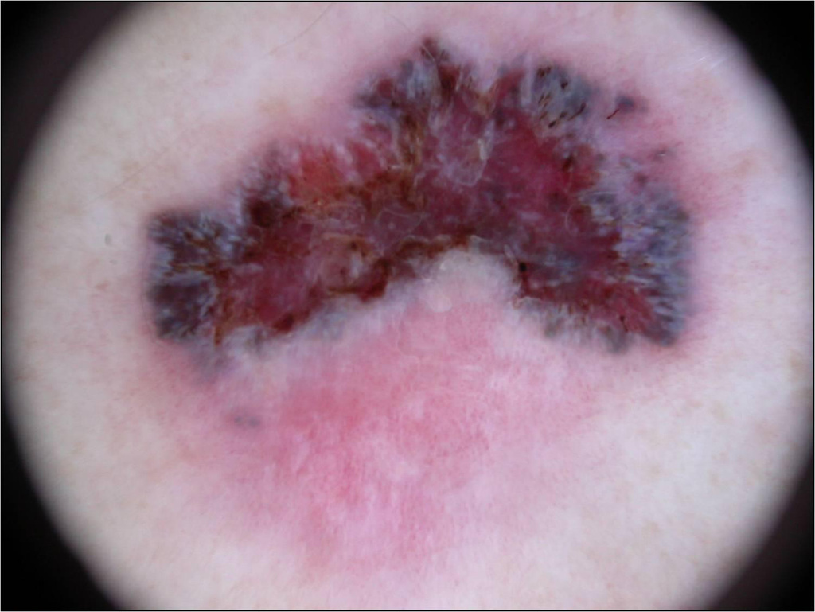

Image Plot With Extracted HOG data
Sample Image(Original)
Sample Image(HOG)

Slide 21
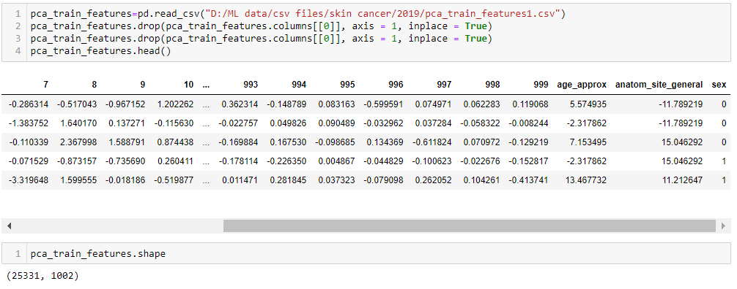
HOG data Concatenated with metadata

Slide 22
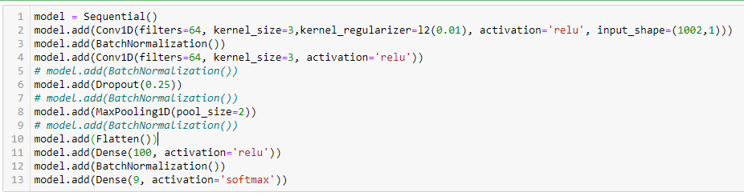
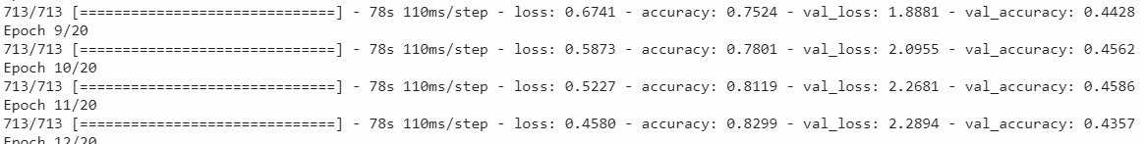
Final Training with sequential Model

Slide 23
Thanks

